Slide 1
Fire Containment in Multi-Story Buildings
Presented by ROXUL, INC. and Thermafiber, Inc. (An Owens Corning Company)
February 24, 2016

Slide 2


Contact Information
Angela M. Ogino, LEED AP
Technical Services Leader
Thermafiber, Inc. Insolutions®
(260) 569-8229
Email: angela.ogino@owenscorning.com
www.thermafiber.com
Melanie Bisson, CSI, CDT
Southeast Territory Sales Manager
Commercial & Residential Solutions
Roxul USA INC.
(413) 265-8915
Email: melanie.bisson@roxul.com
www.roxul.com

Slide 3
Agenda & Learning Objectives
Importance of Fire Containment
Building Code Requirement and ASTM E 2307
Fire Performance of Building Materials
What is Mineral Wool?
Perimeter Fire Containment / Curtain Wall Ratings
Basic Design Principles
Installation
Leap Frog Effect
Engineering Judgments
Q&A

Slide 4
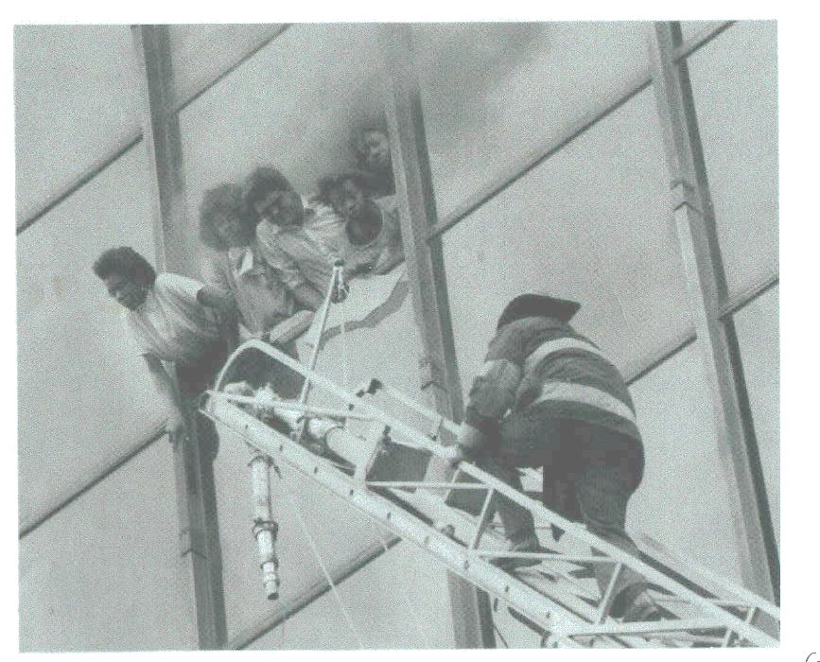
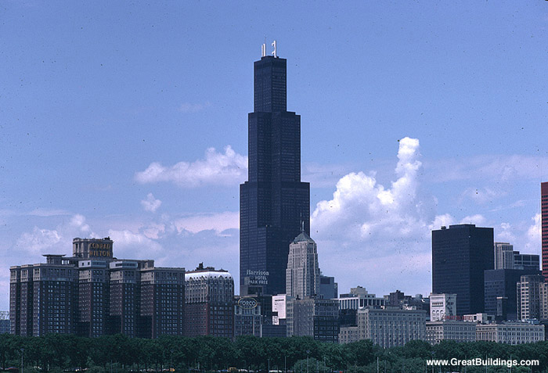
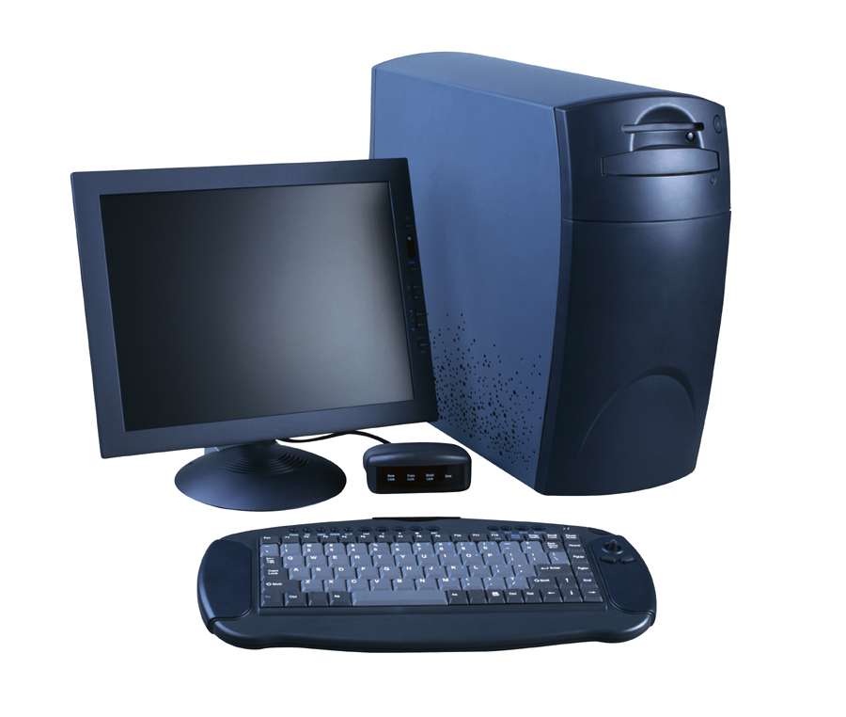

Why is fire containment important?
©2015 Thermafiber, Inc. An Owens Corning Company

Slide 5
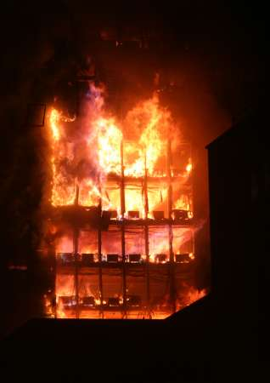
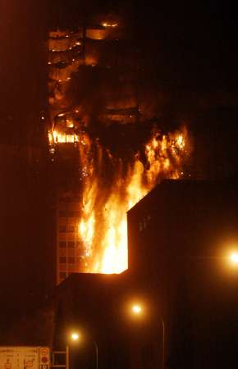
Why is fire containment important?
©2015 Thermafiber, Inc. An Owens Corning Company

Slide 6
Unsealed or Improperly sealed perimeter joints cost lives and huge liability losses…
Summerland, Isle of Man, British Isles. Fire spread through safing slot. 50 people killed.
Hilton Hotel, Las Vegas, NV. Fire spread from 8th to 13th floor in 25 minutes. 8 fatalities.
First Interstate Bank, Los Angeles, CA. Flames spread from 13th to 16th floor via perimeter joint. One death.
One Meridian Plaza, Philadelphia, PA. Fire spread from 22nd to 30th floor through unprotected openings including slab edge.
©2004 International Firestop Council
Notes:
Notes:
All of these incidents represent well known incidents of fire where improper safing or the lack of safing was specifically identified as a cause for the spread of the fire.
One Meridian Plaza above should be discussed as an example of the liability aspects of not doing this work or doing it improperly. THIS BUILDING STOOD VACANT FOR YEARS AFTER THE FIRE AS PART OF THE EVIDENCE for the $350 million in law suits that were filed.
MGM Grand Las Vegas: Many people are unfamiliar with the events shown above. Relate these incidents to the MGM Grand. Even though curtain wall safing was not specifically listed, improper firestopping of all types was. They’ll usually remember this fire.

Slide 7
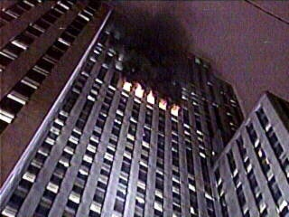
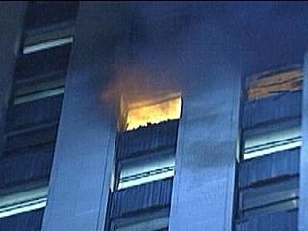
Fire Containment
12/6/04 High-Rise fire
at 135 S. Lasalle Building- Chicago
The fire burned for 6 hours. Fire was contained to the 29th and 30th floors.
©2015 Thermafiber, Inc. An Owens Corning Company

Slide 8
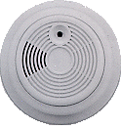
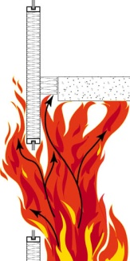

The Balanced Approach
DETECTION
Passive Systems
Active Systems
COMPARTMENTATION
SUPPRESSION
©2015 Thermafiber, Inc. An Owens Corning Company

Slide 9


What do the codes say?
What do the Building Codes say?
©2015 Thermafiber, Inc. An Owens Corning Company

Slide 10
Building Codes – IBC (2015)
Section 705.8.5 Vertical Separation of openings.
Openings in exterior walls in adjacent stories shall be separated vertically to protect against fire spread on the exterior of the buildings where the openings are within 5 feet (1524mm) of each other horizontally and the opening in the lower story is not a protected opening with a fire protection rating of not less than ¾ hour. Such openings shall be separated vertically at least 3 feet (914mm) by spandrel girders, exterior walls or other similar assemblies that have a fire-resistance rating of at least 1 hour or by flame barriers that extend horizontally at least 30 inches (762mm) beyond the exterior wall…
Exceptions:
This section shall not apply to buildings that are three stories or less above grade plane.
This section shall not apply to buildings equipped throughout with an automatic sprinkler system in accordance with section 903.3.1.1 or 903.3.1.2.
This section shall not apply to open parking garages.

Slide 11
Building Codes – IBC (2015)
Section 715.4 Exterior curtain wall/floor intersection. Where fire resistance- rated floor or floor/ceiling assemblies are required, voids created at the intersection of the exterior curtain wall assemblies and such floor assemblies shall be sealed with an approved system to prevent the interior spread of fire. Such systems shall be securely installed and tested in accordance with ASTM E2307 to provide an F rating for a time period not less than the fire- resistance rating of the floor assembly. Height and fire-resistance requirements for curtain wall spandrels shall comply with Section 705.8.5.
Exception: Voids created at the intersection of the exterior curtain wall assemblies and such floor assemblies where the vision glass extends to the finished floor level shall be permitted to be sealed with an approved material to prevent the interior spread of fire. Such material shall be securely installed and capable of preventing the passage of flame and hot gases sufficient to ignite cotton waste where subjected to ASTM E 119 time-temperature fire conditions
under a minimum positive pressure differential of 0.01 inch (0.254 mm)
of water column (2.5 Pa) for the time period equal to the fire-resistance
rating of the floor assembly.

Slide 12
Building Codes – IBC (2015)
Section 715.5 Spandrel wall:
Height and fire-resistance requirements for curtain wall spandrels shall comply with Section 705.8.5. Where Section 705.8.5 does not require a fire-resistance-rated spandrel wall, the requirements of Section 715.4 shall still apply to the intersection between the spandrel wall and the floor.
Section 715.4 …Such systems shall be…installed and tested in accordance with ASTM E 2307 to provide and F rating…

Slide 13
Building Codes – IBC (2012)
Section 715.4 Exterior curtain wall/floor intersection. Where fire resistance- rated floor or floor/ceiling assemblies are required, voids created at the intersection of the exterior curtain wall assemblies and such floor assemblies shall be sealed with an approved system to prevent the interior spread of fire. Such systems shall be securely installed and tested in accordance with ASTM E2307 to provide an F rating for a time period at least equal to the fire- resistance rating of the floor assembly. Height and fire-resistance requirements for curtain wall spandrels shall comply with Section 705.8.5.
Exception: Voids created at the intersection of the exterior curtain wall assemblies and such floor assemblies where the vision glass extends to the finished floor level shall be permitted to be sealed with an approved material to prevent the interior spread of fire. Such material shall be securely installed and capable of preventing the passage of flame and hot gases sufficient to ignite cotton waste where subjected to ASTM E 119 time-temperature fire conditions
under a minimum positive pressure differential of 0.01 inch (0.254) mm)
of water column (2.5 Pa) for the time period equal to the fire-resistance
rating of the floor assembly

Slide 14
Extending the Rated Floor to the Wall...
MANDATORY!
In rated construction, all floors are rated
The perimeter joint must be sealed with an approved material or system that extends this rating to the exterior wall surface
©2004 International Firestop Council
Notes:
Extending the rating of the floor or sealing the safing slot is a mandatory requirement of all major codes.

Slide 15
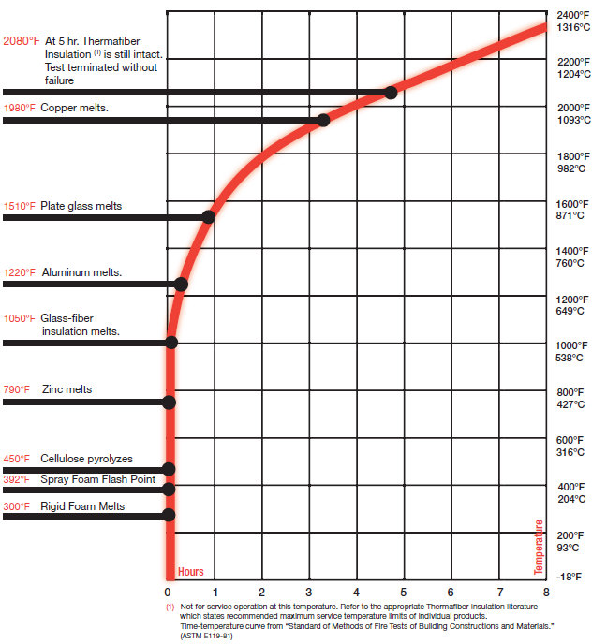
Fire Performance of Mineral Wool
Mineral wool
ASTM E 119 Time Temperature Curve
©2015 Thermafiber, Inc. An Owens Corning Company

Slide 16
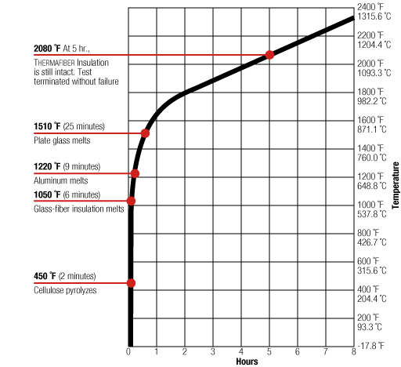
Fire Performance of Mineral Wool
Mineral wool
1050° F (6min)
Materials such as Spray Foam, Zinc, and even Glass Fiber have been compromised.
©2015 Thermafiber, Inc. An Owens Corning Company

Slide 17
Fire Performance of Mineral Wool
Mineral wool
1220° F (9min) aluminum melts
©2015 Thermafiber, Inc. An Owens Corning Company

Slide 18
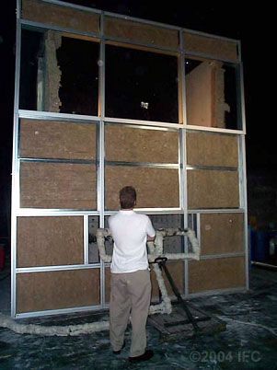
Curtain Wall Test Assembly
Pre-Burn
Transom above floor
Mineral wool insulation at spandrel area
Mechanical attachments supporting insulation
Transom below floor
Mullions
©2004 International Firestop Council
Notes:
NOTES:
Here is an actual test assembly.

Slide 19
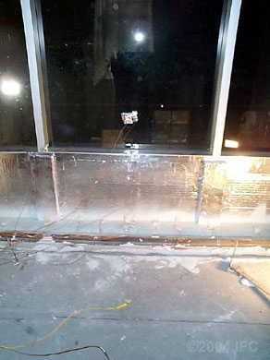
Assembly
Interior View
Pre-Burn
Thermocouples measuring temperature rise
©2004 International Firestop Council
Notes:
This is the interior view of the 2nd floor prior to the start of the test.
The brown line at the base of the wall is the thermocouple bundle (TCs) used to measure the temperature rise on the interior surfaces. This rise is limited to 325 degrees above the ambient starting temperature.
The pale blue area between the TCs and the foil faced insulation is the joint area sprayed with AS200.

Slide 20
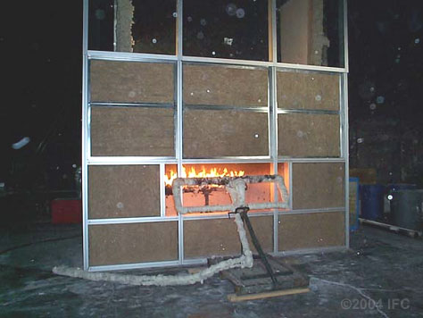
Interior Burner Lit - Time: 0:00
©2004 International Firestop Council
Notes:
At the start of the test the interior burner is ignited.

Slide 21
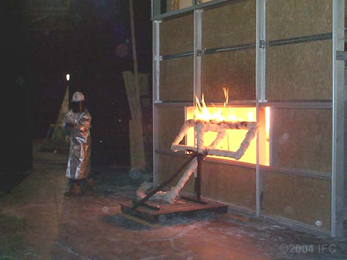
Exterior Burner Lit - Time: 0:05
©2004 International Firestop Council
Notes:
Five minutes after the interior burner is lit, the exterior burner is ignited.

Slide 22
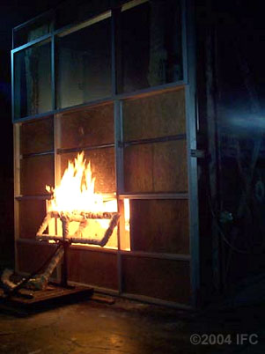
Flames Climbing Exterior
Time: 0:15
©2004 International Firestop Council
Notes:
In this slide, flames begin to play up the exterior of the wall.

Slide 23
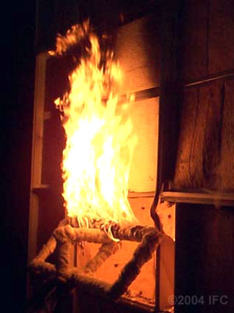
Melting of Mullions
&
Transoms
Time: 0:45
©2004 International Firestop Council
Notes:
At this point, damage to the wall’s aluminum framing structure is becoming obvious. The transom (horizontal framing member) directly over the burner has melted away leaving the light gauge steel perimeter angle that we installed to keep the mineral wool curtain in place.

Slide 24
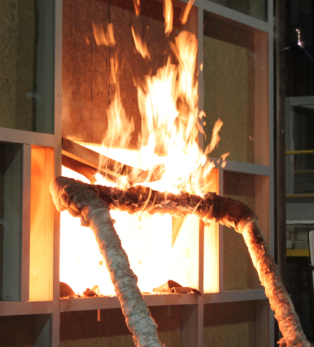

Transom exposure to fire test
Transom bending down 11 min. into test.
©2015 Thermafiber, Inc. An Owens Corning Company

Slide 25
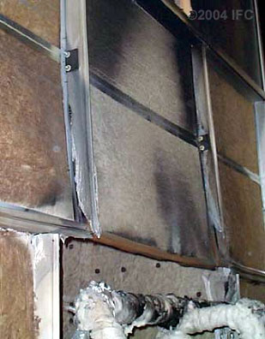
Post Test:
Close up Detail of Mullion and Transom Damage
©2004 International Firestop Council
Notes:
Notice the damage to the mullions (vertical framing supports). This slide illustrates the value of mullion insulating covers. Without them, the fire would have burned through into the interior.

Slide 26
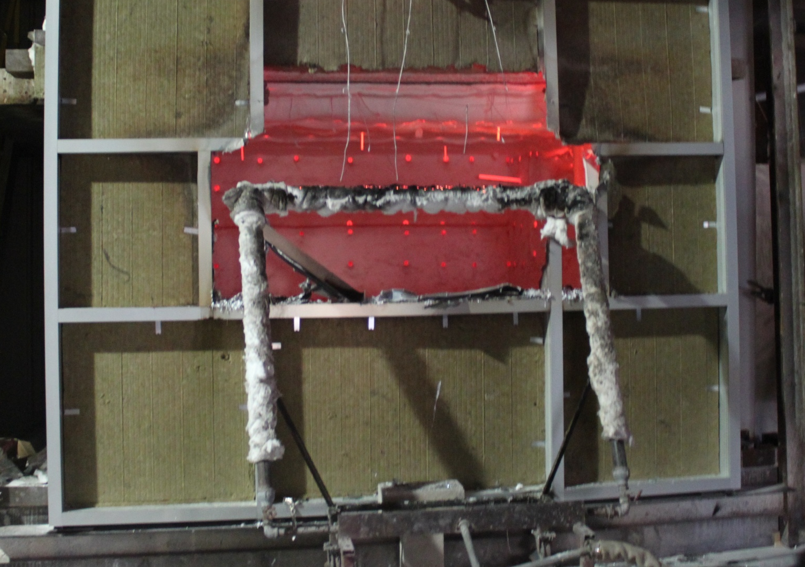
Mullions and Transoms after exposure to fire test
Complete loss of horizontal transom and vertical mullions.
©2015 Thermafiber, Inc. An Owens Corning Company

Slide 27
Fire Performance of Mineral Wool
Mineral wool
1510° F (25 min)
plate glass melts
©2015 Thermafiber, Inc. An Owens Corning Company

Slide 28
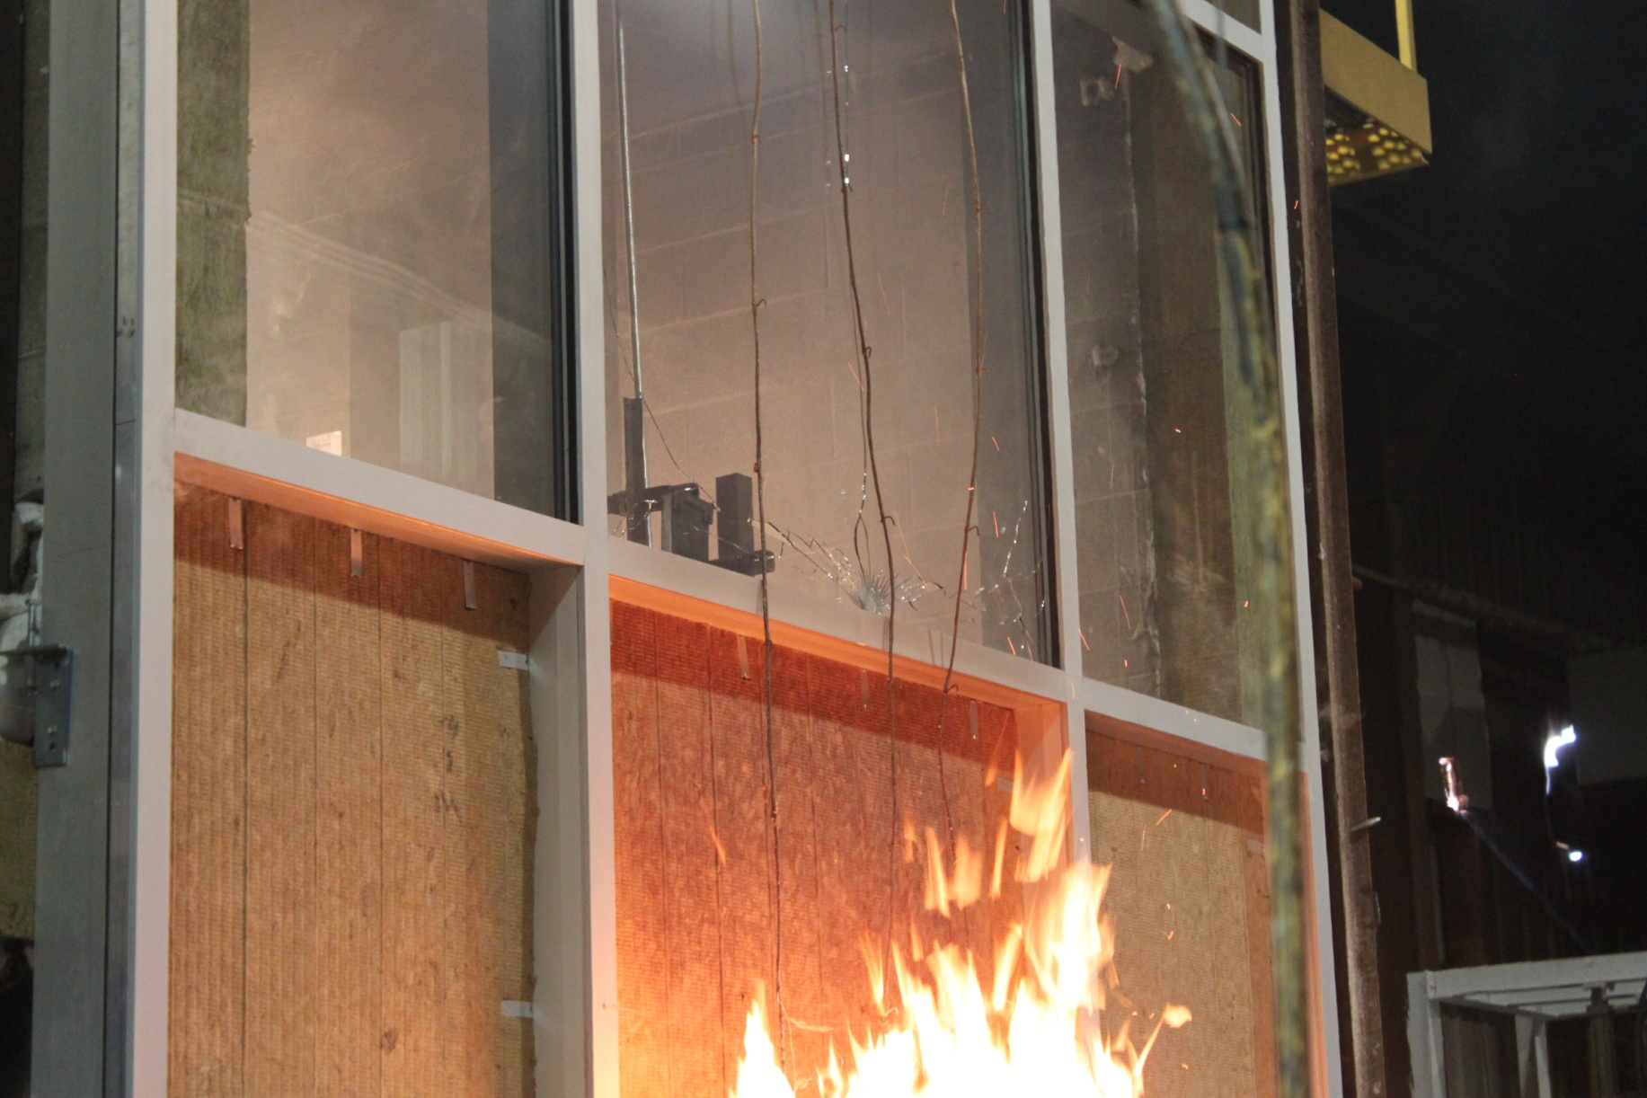
Fire Performance of Mineral Wool
Glass breakage approximately 11 minutes into a fire test.
©2015 Thermafiber, Inc. An Owens Corning Company

Slide 29
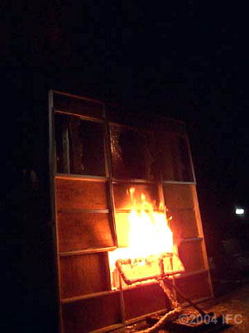
Vision Glass Breaks
Time: 2:00
©2004 International Firestop Council

Slide 30
Fire Performance of Mineral Wool
2080° F
(5 hours) mineral wool still intact
Mineral wool
©2015 Thermafiber, Inc. An Owens Corning Company

Slide 31
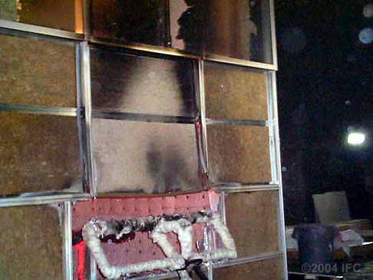
Burner Off at 2 hours
©2004 International Firestop Council
Notes:
At the end of the test as this picture shows… The framing has been severely damaged in the area right above the fire window. The transom (horizontal framing member) directly above the window has melted away. The support structure for the mineral wool insulation is intact however, and has kept the protective envelope in place.

Slide 32
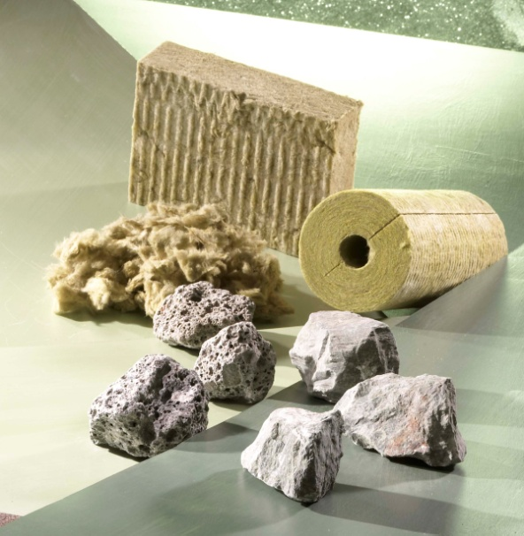
What is Mineral Wool?
Stone wool or “mineral wool” products are made from a combination of natural basalt rock and recycled slag.
Raw Materials are melted into a molten state and then spun into stone fibers.
Minor amounts of binder & oil are added.
Various manufacturers feature up to 40%+ recycled content.

Slide 33
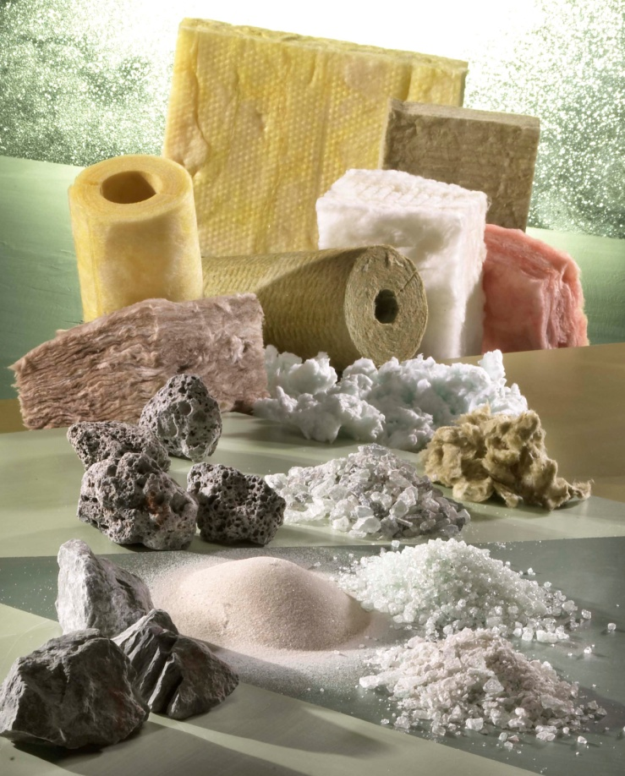
Industry Definition: Mineral Wool
Technical Codes & Standards/Industry Associations define Mineral Wool and Mineral Fiber to include the following:
  Mineral Fiber
    Glass Fiber
    Rock & Slag Fiber
  Mineral Wool (Stone Wool)
    Rock & Slag Fiber (does not include
    glass fiber by definition).
Mineral Fiber raw materials & Finished Goods

Slide 34
Why Specify Mineral Wool?
The Top 6 Reasons
  Fire Resistance
  Sound Absorbency
  Long-term Thermal Resistance
  Dimensional Stability
  Water Repellency
  Vapor Permeability
Notes:
Once again, stone wool should be specified because it can help meet performance characteristics and criteria for fire resistance, water resistance, sound resistance, thermal resistance, dimensional stability, and vapor permeability.

Slide 35
What are the dynamics of vertical spread in a high-rise building?
©2004 International Firestop Council
Notes:
Notes:

Slide 36
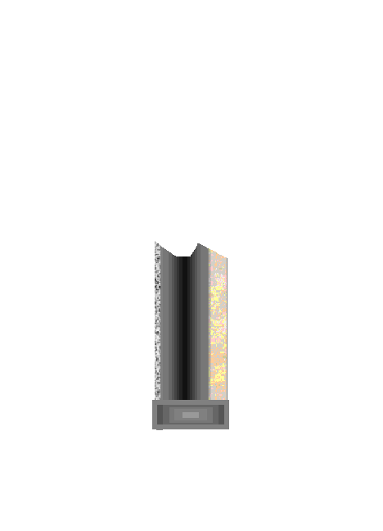
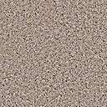


Fire begins on a lower floor, products of combustion accumulate at ceiling level, and positive pressure builds
Rated Floor Assembly and non-rated Curtain Wall System
Vision Glass
©2004 International Firestop Council
Notes:
Notes:
Why is sealing the joint so critical?
During a fire, the heated gasses and the products of combustion naturally rise. This creates positive pressure at the ceiling line. Thus the fire will attack this area first!
Where the fire starts away from this area, an improperly sealed joint becomes a path for smoke and toxic gasses to migrate throughout the building putting the occupants of higher floors at risk and potentially allowing expensive smoke damage to occur in otherwise unexposed areas.
The improperly sealed or unsealed joint also becomes a venting path for the fire. This can draw the fire towards the safing slot and towards the vulnerable non-rated curtainwall.

Slide 37
The fire follows the flow of air currents…
If the void between the floor and curtain wall is not properly sealed, flames will spread vertically…
and compartmentation is breached!
Vision Glass
Rated Floor Assembly and non-rated Curtain Wall System
©2004 International Firestop Council
Notes:
Notes:
In the worst case, compartmentation is breached and the fire is allowed to spread vertically through the safing slot.

Slide 38


Vision Glass
Fire attacks the curtain wall structure from both sides causing a premature failure of the wall structure and potentially the vision glass above!
Elevated temp. and pressure breaks lower vision glass
Flames may erupt through the windows. Oxygen fuels the fire.
Rated Floor Assembly and
non-rated Curtain Wall System
©2004 International Firestop Council
Notes:
Notes:
As superheated gasses and the byproducts of combustion collect within the room, a flash over eventually ignites the entire room and the window glass will shatter allowing the flames to play out of the windows and up the exterior of the building.
The shattered windows provide oxygen to the fire.

Slide 39
A properly designed & tested Perimeter Fire Barrier System
not only protects the perimeter joint but critical wall framing and support elements as well!
Firestop Coating or Sealant over mineral wool safing
Properly installed & supported mineral wool spandrel insulation
Rated Floor Assembly and non-rated Curtain Wall System
©2004 International Firestop Council
Notes:
Notes:
The purpose of the Perimeter Fire Barrier System is to make sure that the safing slot remains sealed for the full duration of the floors rating and to maximize the performance of the non-rated wall..

Slide 40
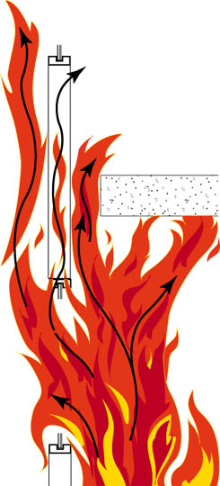
Paths of Fire Propagation
©2015 Thermafiber, Inc. An Owens Corning Company

Slide 41
How Are Perimeter Fire Barrier Systems Tested?
©2004 International Firestop Council
Notes:
Notes:

Slide 42
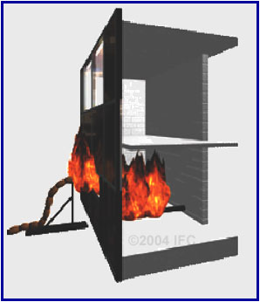
ASTM E2307
Standard Test Method for Determining Fire Resistance of Perimeter Fire Barriers Using Intermediate-Scale, Multi-Story Test Apparatus
©2004 International Firestop Council
Notes:
NOTES:
The fire is ignited within the burn room.
At 5 minutes, the exterior burner is ignited and begins to play up the exterior of the curtain wall assembly.

Slide 43
How Are Perimeter Fire Barrier Systems Tested?
Only two labs presently perform testing in accordance with newly developed test methods:
Underwriters Laboratories Inc. – Northbrook, IL
Intertek/Omega Point Laboratories – Elmendorf, Texas
©2004 International Firestop Council
Notes:
Notes:
At this time, two laboratories are equipped Perimeter Fire barrier testing. The not-for-profit Underwriters Laboratories in Northbrook, Il and a private commercial laboratory named Omega Point located outside of San Antonio, Texas.

Slide 44
UL & OPL Testing
Perimeter joint curtain wall test is
performed in accordance with ASTM E2307
Other labs, testing per UL 2079 alone, do
not adequately capture the dynamics
between a rated floor and a non-rated
curtain wall assembly, the structural nature
of curtain walls, and fire attacking at two planes
Intermediate-Scale, Multi-Story Test Apparatus (ISMA) was developed for this application
©2004 International Firestop Council
Notes:
NOTES:
The UL test utilizes the ISMA (Intermediate Multi-Story Apparatus) and is a hybrid method based upon ICBO acceptance criteria and UL2079.
This test was developed as a method of testing the surface flammability of synthetic stucco (EIFS) walls.
UL2079 is not appropriate for testing these applications because it is a test for joints occurring between TWO RATED SURFACES. The safing slot lies between a RATED FLOOR and a NON-RATED EXTERIOR WALL. UL2079 also exposes only one side of the assembly to the fire. The hybrid test attacks the assembly on two planes.
Hence F-W-D (floor to wall, dynamic) systems are not appropriate.

Slide 45
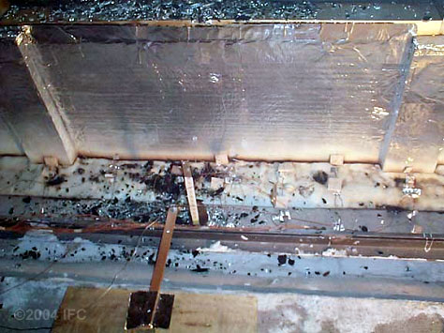
Post Test – Interior View
©2004 International Firestop Council
Notes:
This interior photo taken after the test illustrates that the coating is intact. A slight gap is showing up against the spandrel insulation. This is the toughest area to protect and would be the failure point if the test were to continue. Having good stiffback support in this area has protected the gap and kept it closed for the full duration of the test.

Slide 46
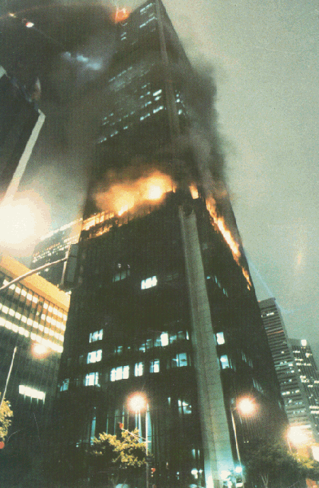
Perimeter Fire Containment
How Is a Fire
Like This Contained?
©2015 Thermafiber, Inc. An Owens Corning Company

Slide 47
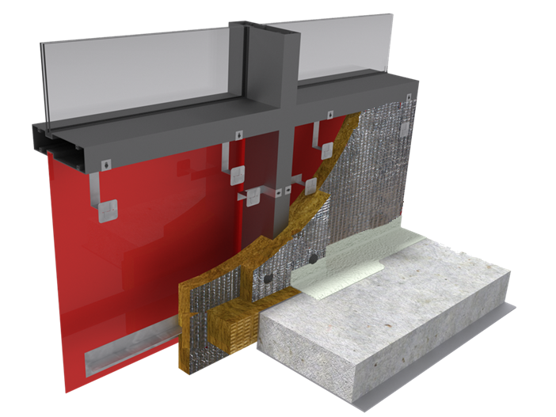
Perimeter Fire Containment
©2015 Thermafiber, Inc. An Owens Corning Company

Slide 48
Basic Design Principles
Reinforcement Member Mechanically Attached
©2015 Thermafiber, Inc. An Owens Corning Company

Slide 49
Basic Design Principles
Mineral Wool Insulation
©2015 Thermafiber, Inc. An Owens Corning Company

Slide 50
Basic Design Principles
Mineral Wool Insulation -Mechanically Attached
©2015 Thermafiber, Inc. An Owens Corning Company

Slide 51
Basic Design Principles
Compression Fit Safing (Direction of Safing as required
per tested assembly)
©2015 Thermafiber, Inc. An Owens Corning Company

Slide 52
Basic Design Principles
Protect Mullions with Mineral Wool Insulation
©2015 Thermafiber, Inc. An Owens Corning Company

Slide 53
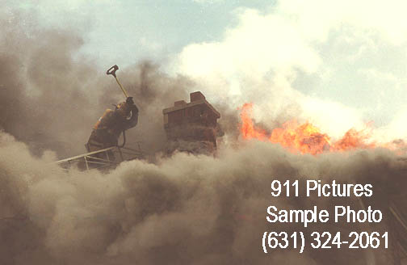
Smoke- The known killer
The major contributor of fire related deaths
is smoke inhalation
©2015 Thermafiber, Inc. An Owens Corning Company

Slide 54
Basic Design Principles
Smoke Barrier
©2015 Thermafiber, Inc. An Owens Corning Company

Slide 55
Basic Design Principles
Mechanically Attached
Protect Mullions
Reinforcement Member
Compression Fit Safing
Mineral Wool Insulation
Smoke Barrier
©2015 Thermafiber, Inc. An Owens Corning Company

Slide 56
Basic Design Principles
The Six Basic Components of Any Listed Perimeter Fire Containment Assembly
Mineral wool insulation
Provide Backing/Reinforcement at the Safing Line
Mechanically Attached Curtain Wall Insulation
Compression-fit Safing Insulation
Protect Aluminum Mullions
For “Smoke Containment,” Apply a Smoke Barrier System
©2015 Thermafiber, Inc. An Owens Corning Company

Slide 57
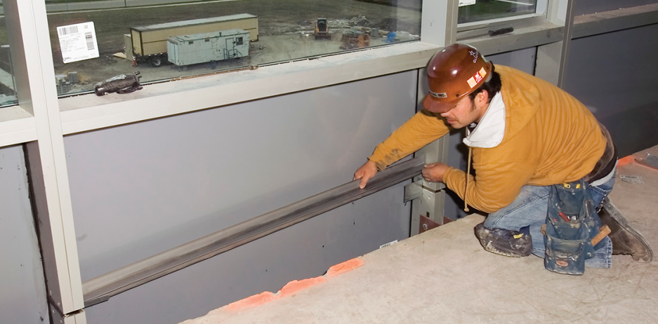
Installation
©2015 Thermafiber, Inc. An Owens Corning Company

Slide 58
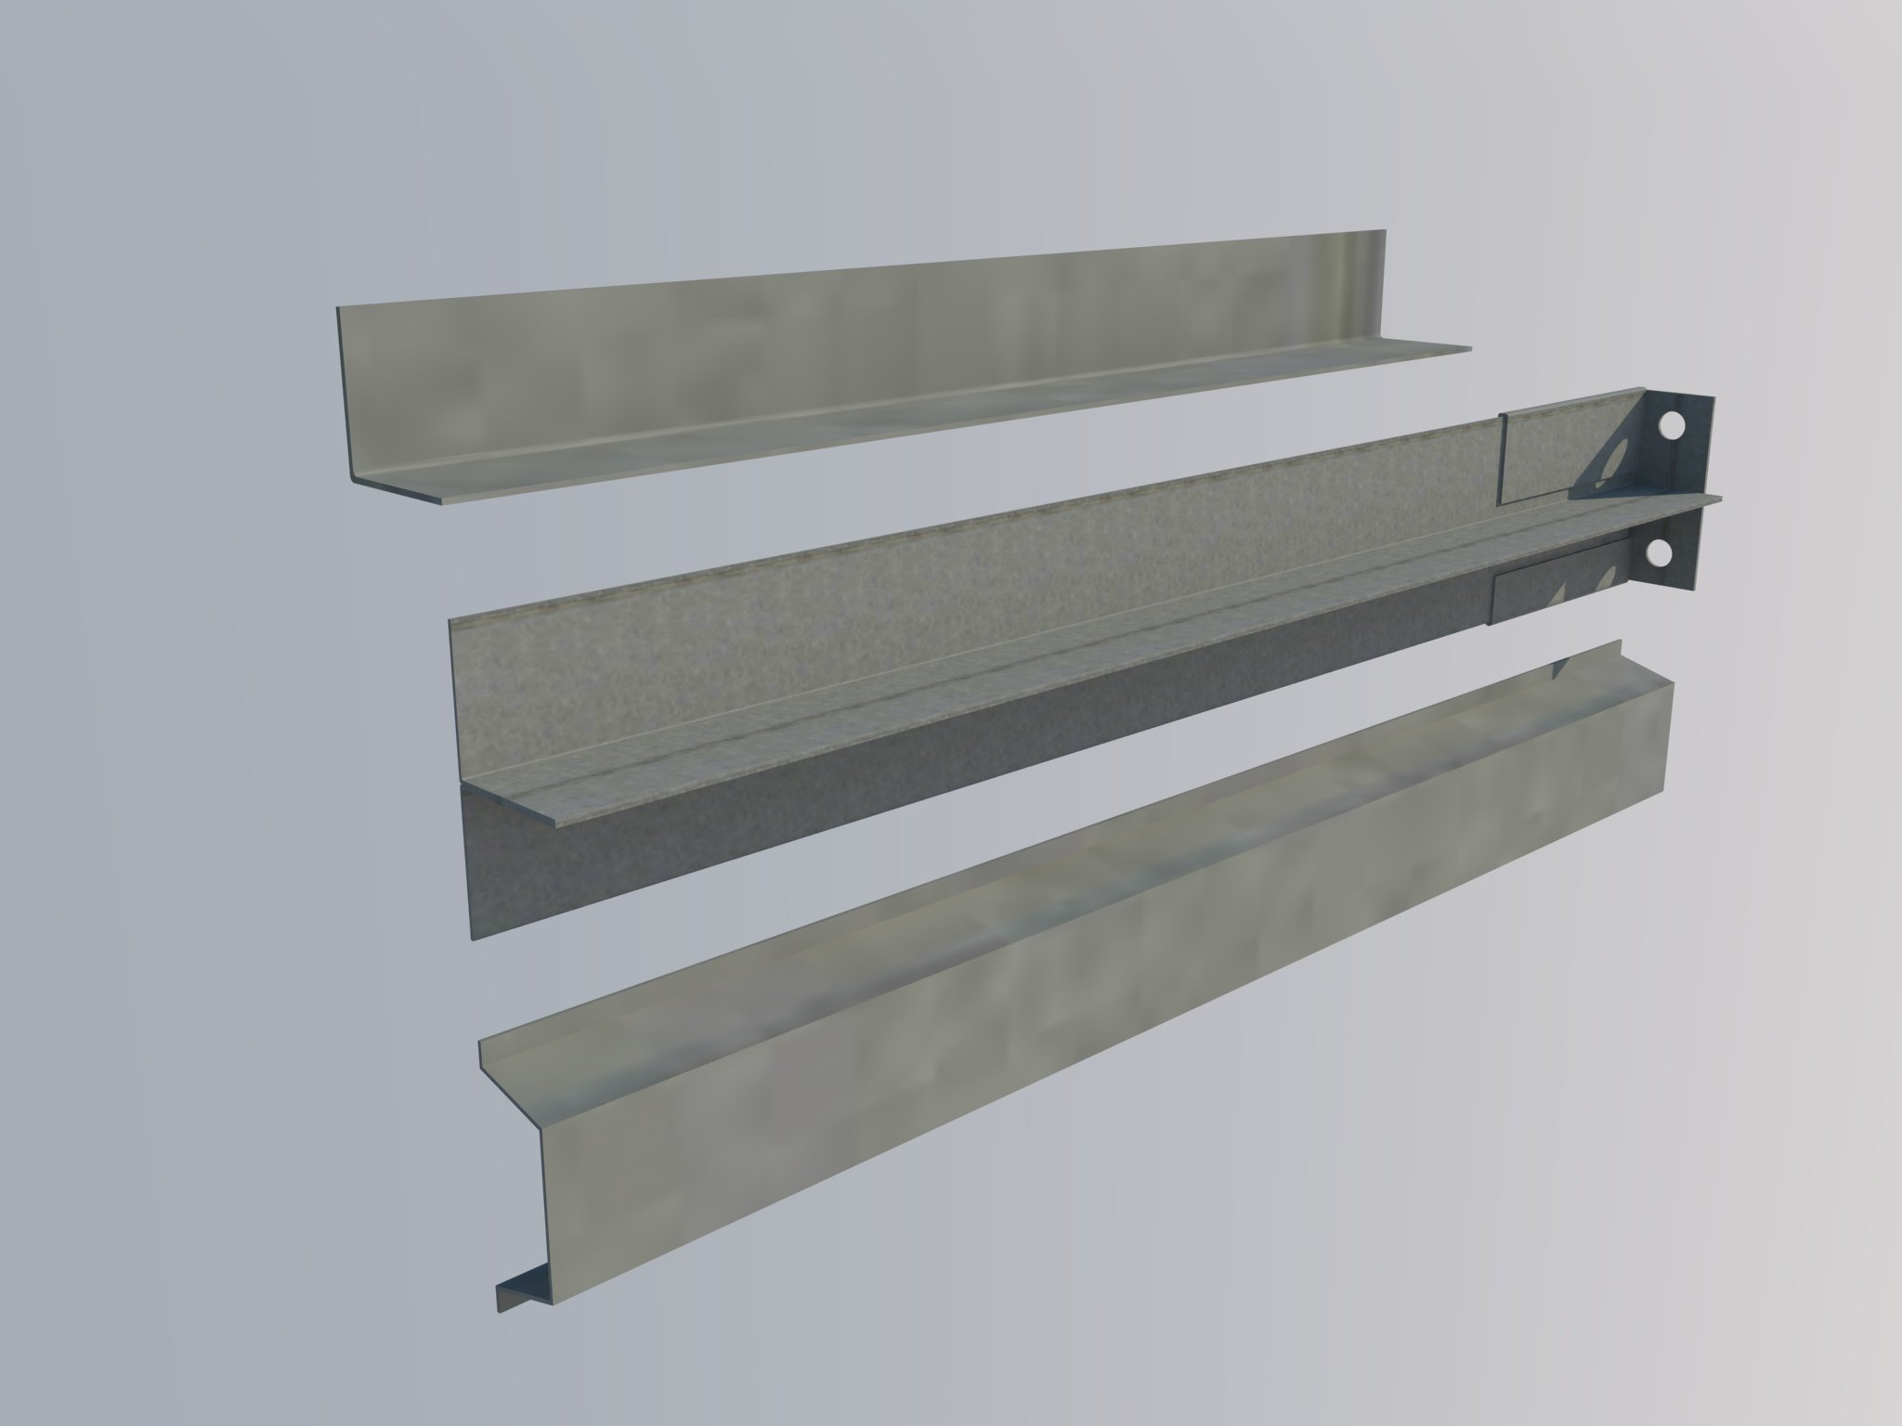
Installation
Backer/Reinforcement Bars
L- Angle
T - Bar
Hat Channel
©2015 Thermafiber, Inc. An Owens Corning Company

Slide 59
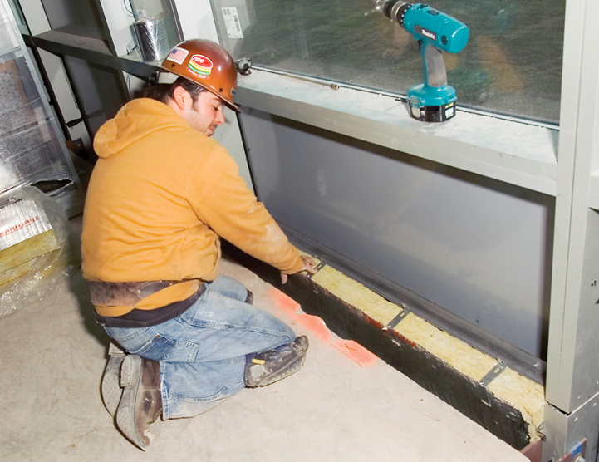
Installation
©2015 Thermafiber, Inc. An Owens Corning Company

Slide 60
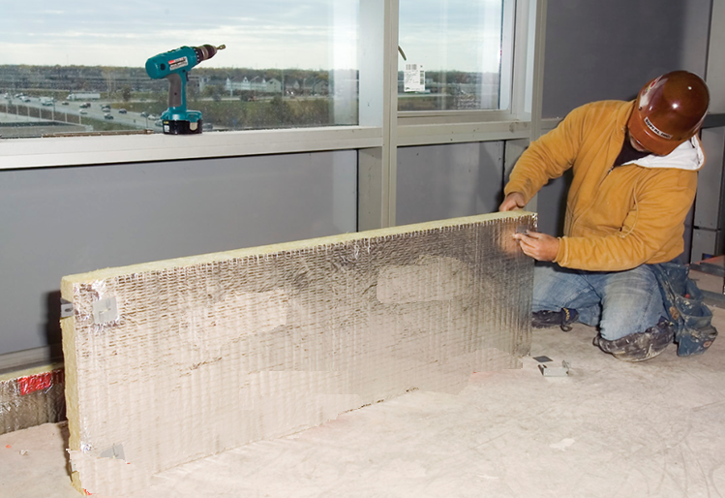
Installation
©2015 Thermafiber, Inc. An Owens Corning Company

Slide 61
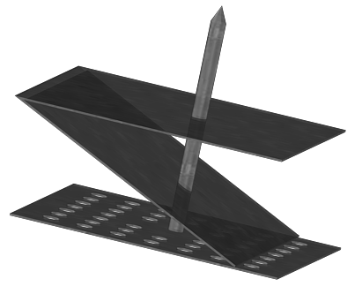
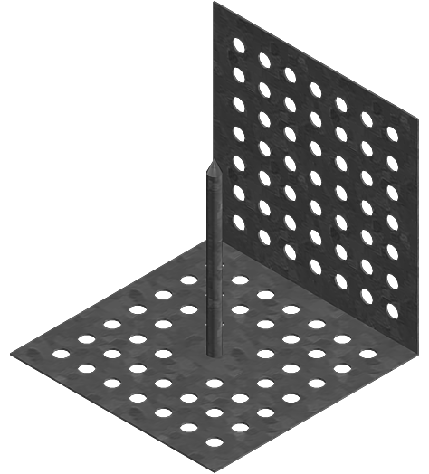
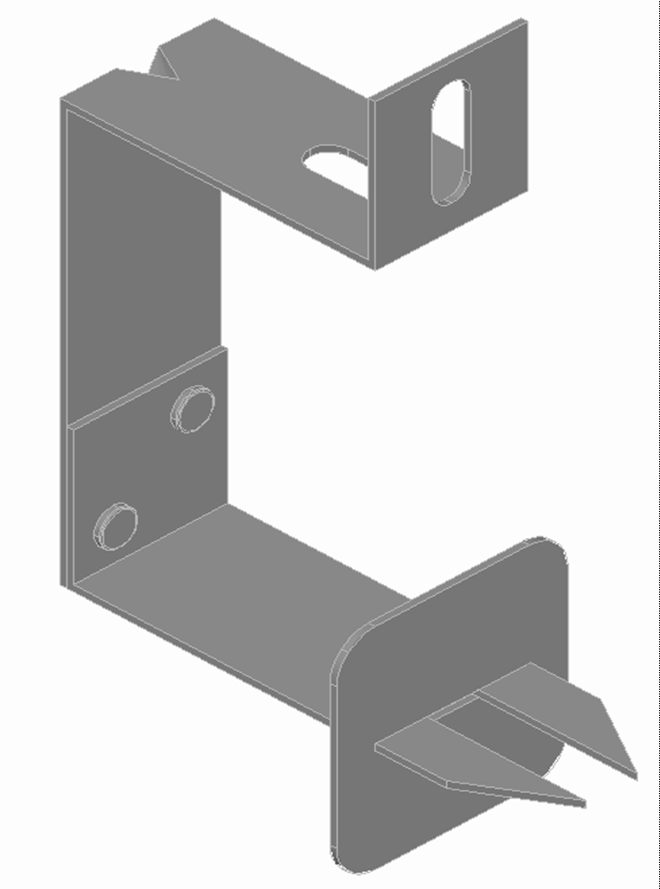
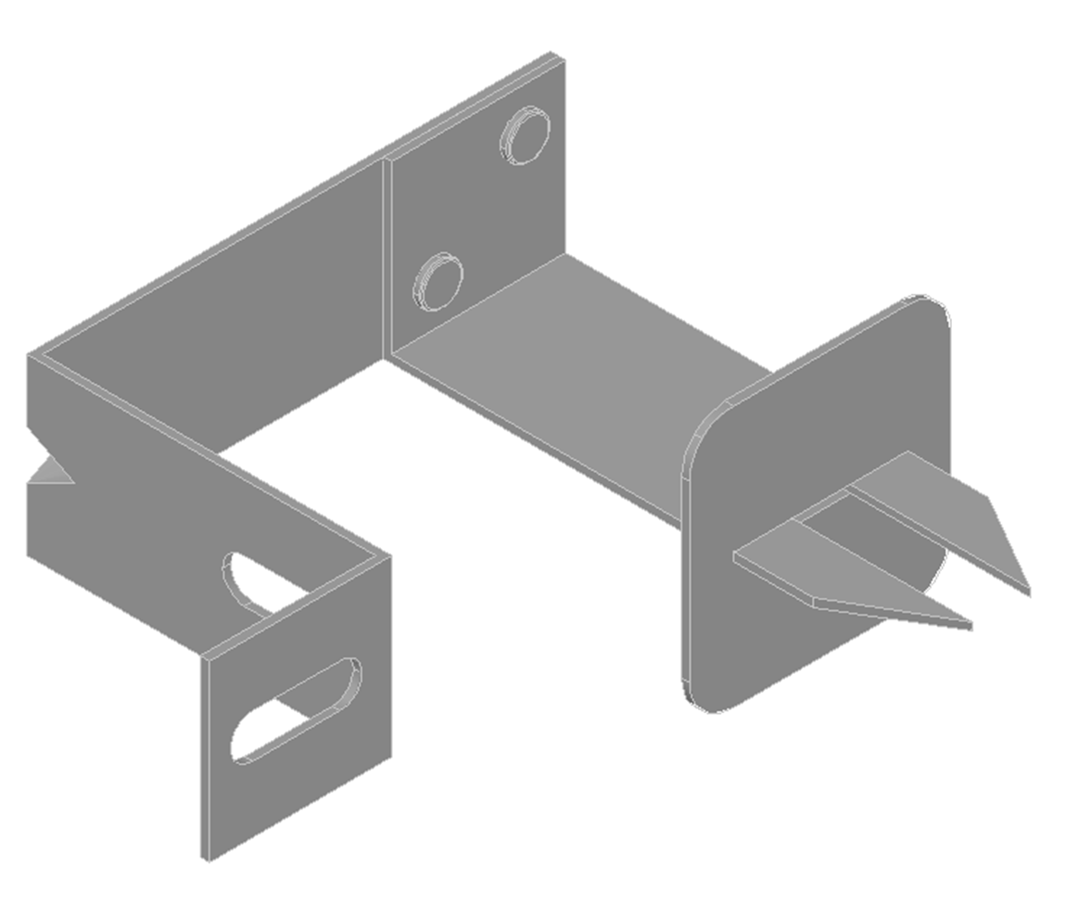
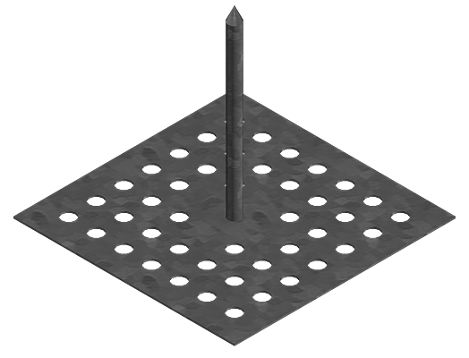
Installation
Mechanically Attached Hangers
©2015 Thermafiber, Inc. An Owens Corning Company

Slide 62
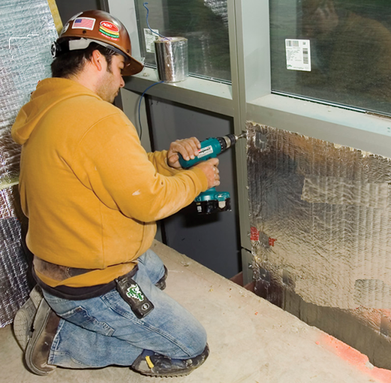
Installation
©2015 Thermafiber, Inc. An Owens Corning Company

Slide 63
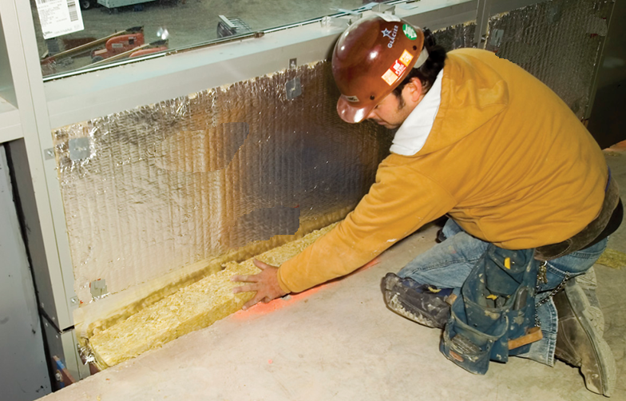
Installation
©2015 Thermafiber, Inc. An Owens Corning Company

Slide 64
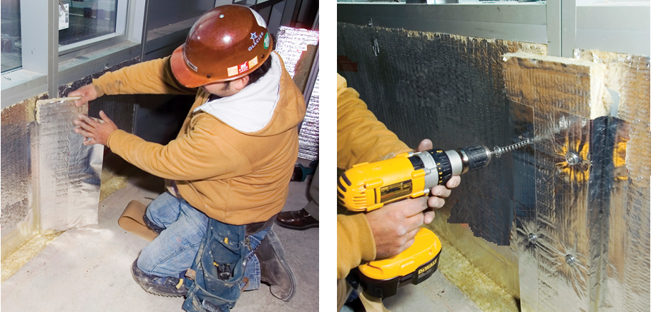
Installation
©2015 Thermafiber, Inc. An Owens Corning Company

Slide 65
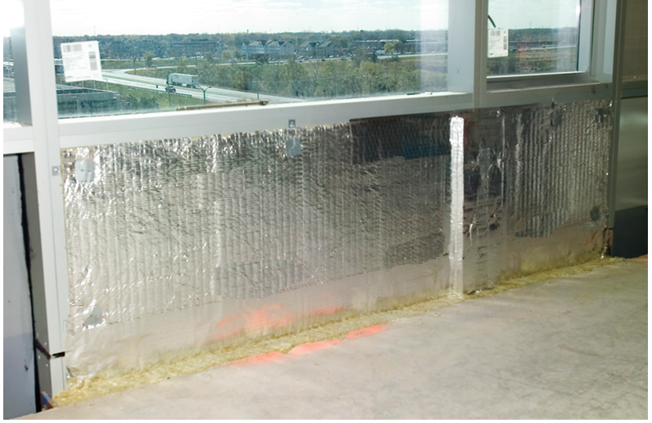
Installation
©2015 Thermafiber, Inc. An Owens Corning Company

Slide 66
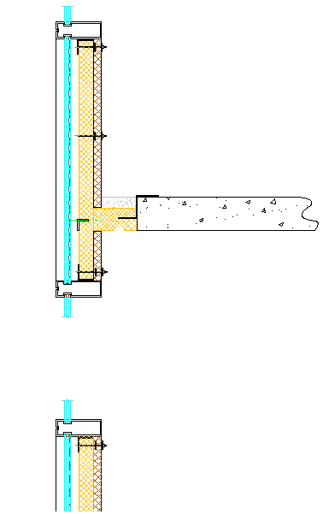
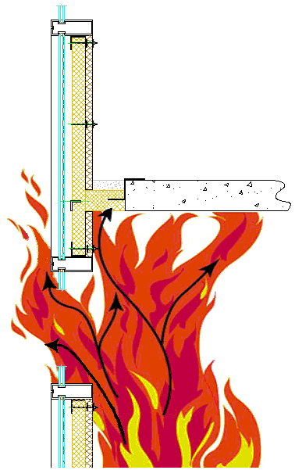
Perimeter Fire Containment
©2015 Thermafiber, Inc. An Owens Corning Company

Slide 67
The Leap Frog Effect…
©2004 International Firestop Council
Notes:
Let’s talk about leap frogging.

Slide 68
The Leap Frog effect…
Fire may break out of a window and leap back to the floor above!
That being the case… Why bother to protect the perimeter???
©2004 International Firestop Council
Notes:
Fire breaking out one window and back in through the windows on the floor above is referred to as leap frogging.
Leap Frogging CAN happen!
If it can happen… Why bother to protect the slot?
This is a question that we frequently hear.

Slide 69
The Leap Frog effect…
Sprinklers are an exception to window separation requirements…
But not to requirements for protection of safing slot!
©2004 International Firestop Council
Notes:
Sprinkler advocates claim that fire is not a big issue in a properly sprinklered building. In fact, the codes contain exceptions to spacing requirements where sprinklers are used.
Yes… Sprinklers are an exception but keep in mind… If Leap Frogging is a concern… Then the sprinklers have failed or have been ineffective at knocking down the fire!
At any rate, whether the building is sprinklered or not, THE SAFING SLOT MUST BE SEALED!

Slide 70
The Leap Frog effect…
Sprinkler advocates are lobbying to reduce these requirements…
After all… The fire may jump around the protection!
©2004 International Firestop Council
Notes:
Sprinkler advocates have been lobbying the codes to reduce safing requirements. They argue that in the event of a fire, the fire can simply go around the safing slot.

Slide 71
The Leap Frog affect…
The fact is, depending on window spacing and other factors, the fire may jump!
So what exactly does a Perimeter Fire Barrier System do?
©2004 International Firestop Council
Notes:
Leap Frogging CAN happen! And obviously it can occur faster and easier as the window spacing is reduced. But a well designed Perimeter Fire Barrier System still offers a number of important advantages…

Slide 72
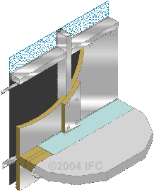
The Perimeter Fire Barrier System…
Slows the process down. Of course it depends on window spacing and other construction factors…
As well as the nature and severity of the fire…
©2004 International Firestop Council
Notes:
Installing a properly designed Perimeter Fire barrier System maximizes the wall’s performance at any given window spacing. A lot depends on the severity of the fire. Experts argue both ways in regards to the severity of the ISMA test. Some think it is too severe. Others feel the opposite. No matter which way… We know that we can improve wall performance with properly designed and installed systems and we think that is the true intent of the codes.

Slide 73
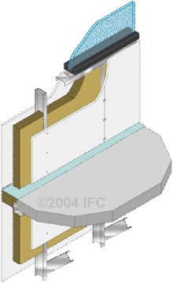
The Perimeter Fire Barrier System…
Along with sealing the slot area, a well engineered system provides structural protection and maximizes the integrity of the wall system…
Keeping the wall and window system above intact longer!
©2004 International Firestop Council
Notes:
It wouldn’t do much good to seal the safing slot if the wall simply failed around it. There are ways to extend the performance of the walls and our engineering and testing are helping to develop them!
Structurally, the non-rated wall is the obvious weak link. However, we are finding that a well engineered system can afford added protection to the wall.
For example… Adding steel reinforcements keeps the mineral wool spandrel insulation in place and in many cases, prevents mullions from melting out beyond the floor line. This keeps windows and spandrel panels intact longer.
Proper location and protection of wall mounting brackets also helps to keep the wall in contact with the safing seal.

Slide 74
The Perimeter Fire Barrier System…
Extends the rating of the floor to the wall.
Forces the fire to exit the building in order to propagate to upper floors.
Protects structural elements and helps prevent catastrophic failure of the spandrel system.
Maximizes fire protection afforded by the
non-rated wall.
©2004 International Firestop Council
Notes:
In summary…
Proper sealing of the safing slot meets the code requirement in regards to extending the rating of the floor to the exterior wall.
Sealing of the safing slot also contains the fire at least until the fire breaks out of the windows. Proper sealing also prevents the wall area from being attacked from both sides (internally and externally).
These systems are engineered to provide protection of critical structural elements. The wall performs as well as it possibly could.

Slide 75
The Perimeter Fire Barrier System…
Prevents the migration of flame, hot gases and smoke through to floors above.
Buys time for occupants to escape.
Buys time for first responders to secure the building
Provides additional protection in the event of a sprinkler or detection failure.
©2004 International Firestop Council
Notes:
In most fires, smoke is the big killer. The spray membrane is simply a better and more reliable smoke sealing method than foil and caulk beads.
Whether fire can leap frog through the glass or not… Maximizing protection should be the goal. Even 5 minutes in an emergency situation has the potential to save lives. We owe it to the occupants of buildings to give them as much time to safely evacuate as possible.
Sprinklers can and do fail. Sometimes they are turned off for some reason. In an earth quake, water may simply be unavailable. Passive fire protection provides the back up and helps to save lives.

Slide 76

The Perimeter Fire Barrier System…
Provides energy savings through increased thermal efficiencies throughout the life of the building…
When considered this way, the life safety benefits are free!
©2004 International Firestop Council
Notes:
Using a Perimeter Fire Barrier System doesn’t really add to the cost. An argument can be made that this type of sealing method actually makes the building tighter by providing the continuous membrane as well as a more uniform and continuous insulation envelope.

Slide 77
Understanding Designs
Reading and Understanding Perimeter Fire Containment Systems
Static or Dynamic
CW-D-/ CW-S-/ TFL/BPF-120-08
Insulation Rating- Hour
(Max temp rise not to exceed 325º F max individual or 250º F average above the starting temp on unexposed surface or 1” above)
L Rating- Hour
Measure of air leakage in CFM/Linear Ft. @ ambient & 400º F
Movement Capabilities
Vertical Shear & Horizontal Movement
©2015 Thermafiber, Inc. An Owens Corning Company

Slide 78


Understanding Designs
F- Rating- Hour
Integrity Rating- Hour
(Interior Spread per ASTM E 2307)
(Interior Spread & Leap Frog)
F Rating — 2 Hr
Integrity Ratings — 1-1/2 and 2 Hr
©2015 Thermafiber, Inc. An Owens Corning Company

Slide 79



Where are listed systems?
Within these two directories there are over 275 tested and listed perimeter fire containment systems.
©2015 Thermafiber, Inc. An Owens Corning Company

Slide 80

Engineering Judgments
©2015 Thermafiber, Inc. An Owens Corning Company

Slide 81
Questions?

Slide 82
Contact Information
Angela M. Ogino, LEED AP
Technical Services Leader
Thermafiber, Inc. Insolutions®
(260) 569-8229
Email: angela.ogino@owenscorning.com
www.thermafiber.com
Melanie Bisson, CSI, CDT
Southeast Territory Sales Manager
Commercial & Residential Solutions
Roxul USA INC.
(413) 265-8915
Email: melanie.bisson@roxul.com
www.roxul.com

Slide 83
Fire Containment in Multi-Story Buildings
Presented by ROXUL, INC. and Thermafiber, Inc. (An Owens Corning Company)
February 24, 2016

